Slide 1
To what extent can U.S. private investment solve poverty in Africa?
Dr. Michael Nicholson, US Agency for International Development
and
Dr. David Kritzberg, Appian Data Services
January 2020

Slide 2
Overview
To what extent does two-way trade and investment between the United States and Africa help achieve the Sustainable Development Goals?
Despite the debate about the extent trade openness benefits poor people in developing countries, the literature has been slow to address the impact of Foreign Direct Investment (FDI) and associated changes in relative factor prices.
Using a panel of trade, investment, and poverty data, this paper will identify the extent to which FDI flows from the United States to Africa, as well as the reverse, impact key SDG targets.

Slide 3
Background
Africa’s population is expected to grow from 1.2 billion in 2015 to 1.7 billion by 2030, with expended spending increasing from $4 trillion to $6.6 trillion.
Over 80 percent of this population growth is expected in cities.
Economic growth across the sub-continent averaged 5.8 percent from 2004 to 2004, but has not created quality jobs.
Per OECD (2018), vulnerable employment will remain at 66 percent of the population through 2022.

Slide 4
Prosper Africa
The U.S. government is making the bet that increasing trade and investment will help break this vulnerability.
The US government announced the “Prosper Africa” initiative in June 2018 to advance mutually beneficial trade and commercial ties between the United States and countries across the African continent, with the bold goal to double trade and investment.
The U.S. government has initiated this work because its trade relationship with sub-Saharan Africa has been declining.
China’s trade now surpasses the United State in trading with Africa and may soon surpass it in foreign direct investment with its public and private investment falling behind China.

Slide 5
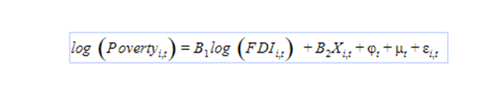
Econometric specification
Replication of Maelan Le Goff and Raju Jan Singh (2014) “Does trade reduce poverty? A view from Africa”

Slide 6
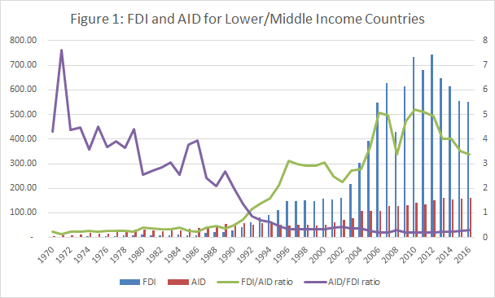
Trends in development aid and FDI in Africa
Nicholson (2012):
Africa can be categorized as an “AID-oriented region” throughout the latter half of the twentieth century, relying on its primary source of external capital in the form of concessionary loans

Slide 7
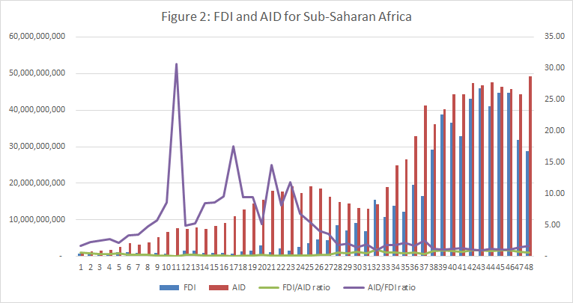
Trends in development aid and FDI in Africa
But the trend for LMIs is not as obvious in Africa

Slide 8
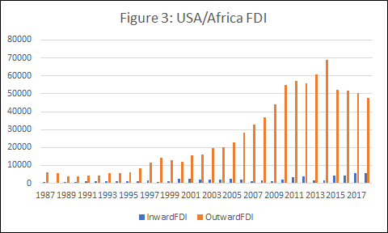
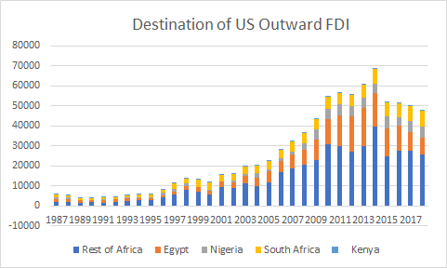
US FDI into Africa dwarfs Africa investment in USA
US Foreign Direct Investment tends to be located in South Africa, Nigeria, and Egypt
source: https://apps.bea.gov/iTable/index_MNC.cfm

Slide 9
Data source: World Bank WDI
Indicator Name
Poverty Headcount | Poverty headcount ratio at $1.90 a day (2011 PPP) (% of population)
Poverty Gap | Poverty gap at $1.90 a day (2011 PPP) (%)
ODA | Net official development assistance and official aid received (current US$)
FDI | Foreign direct investment, net inflows (current US$)
GDP | Adjusted net national income (current US$)
Inflation | Inflation, GDP deflator (annual %)
Credit | Domestic credit provided by financial sector (% of GDP)
Education | Gross intake ratio in first grade of primary education, total (% of relevant age group)
Institutions | CPIA public sector management and institutions cluster average (1=low to 6=high)

Slide 10
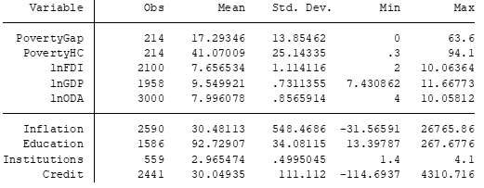
Summary Statistics

Slide 11
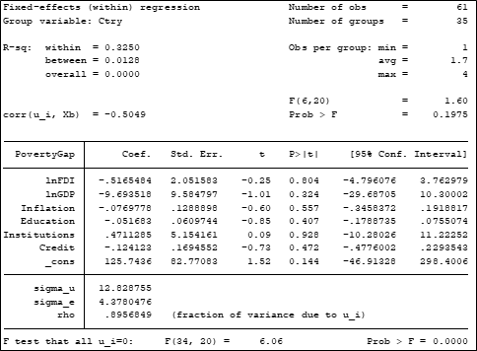
Poverty Gap Results

Slide 12
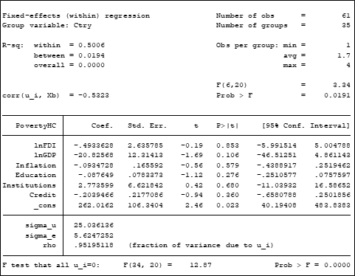
Poverty Headcount Results

Slide 13
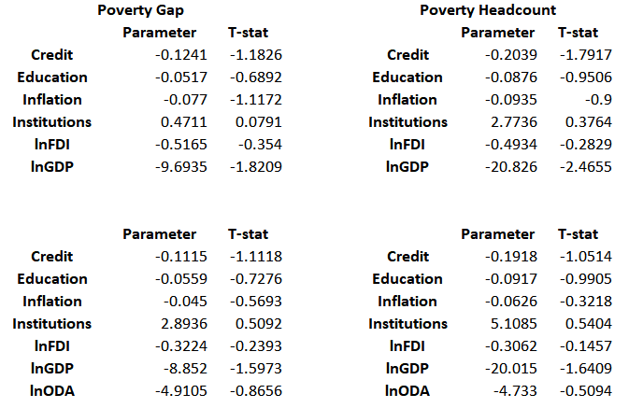
Results

Slide 14
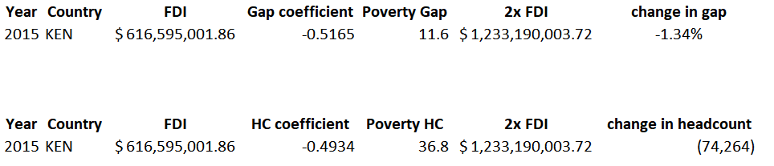
Stylized Example

Slide 15

Conclusions

